Slide 1


Slide 2
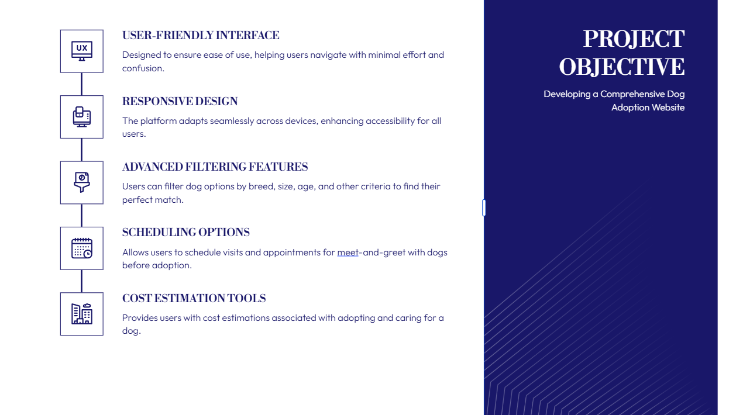

Slide 3
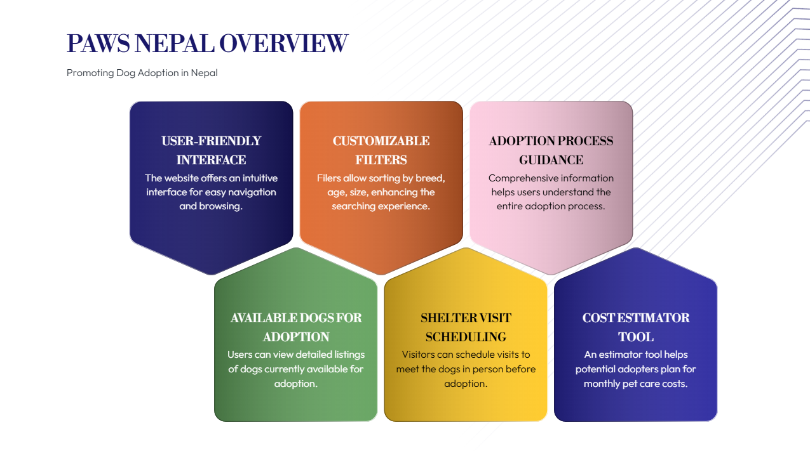

Slide 4
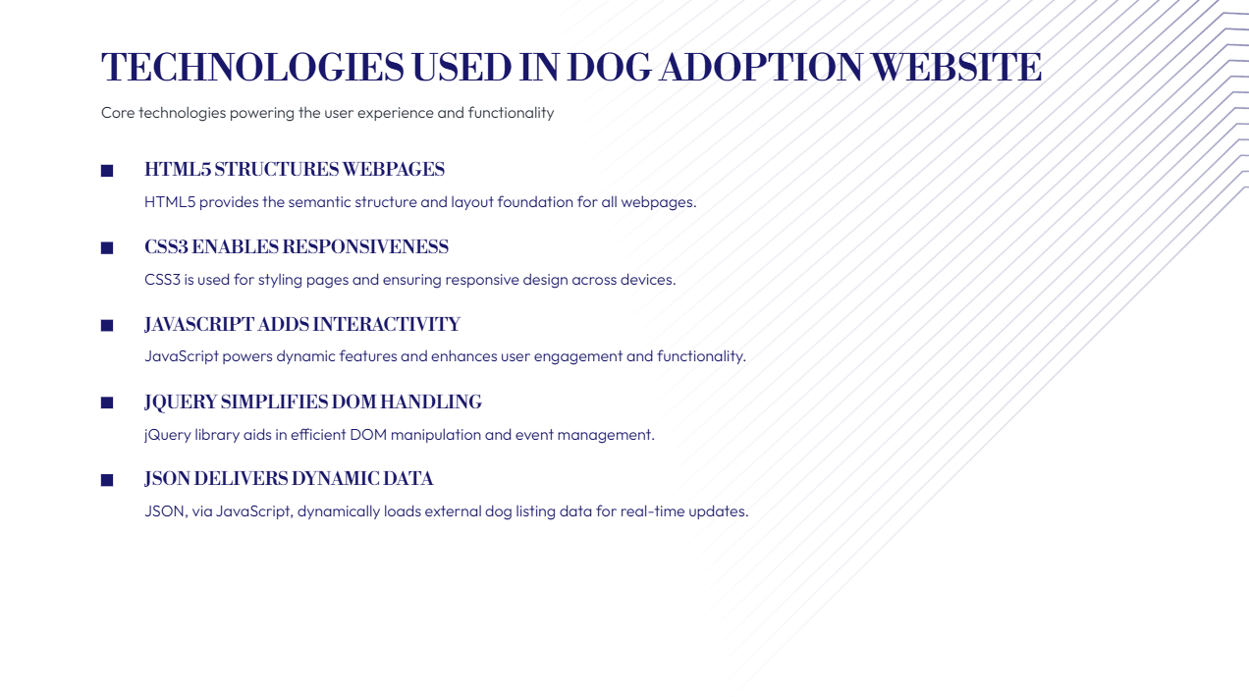

Slide 5


Slide 6
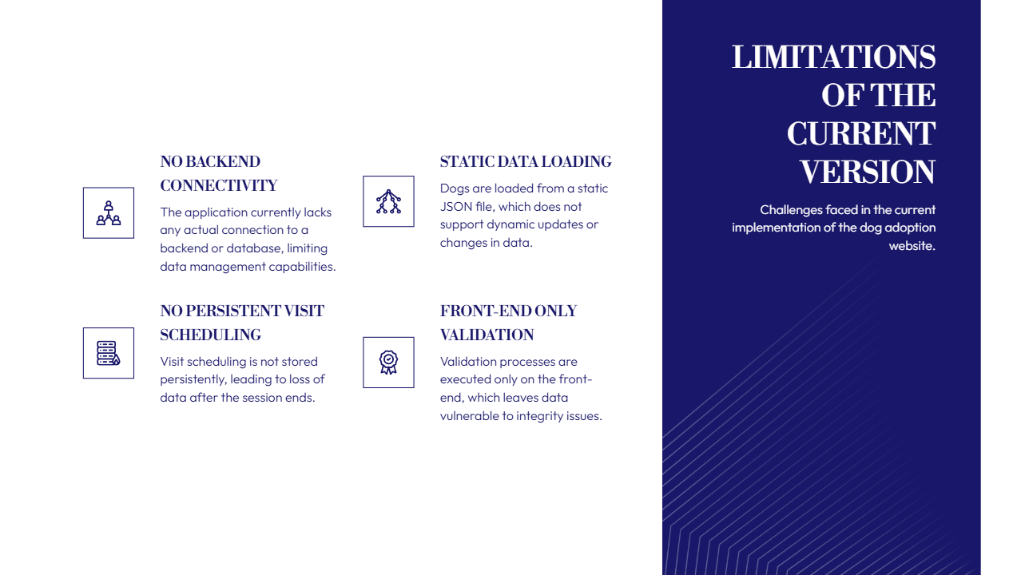

Slide 7
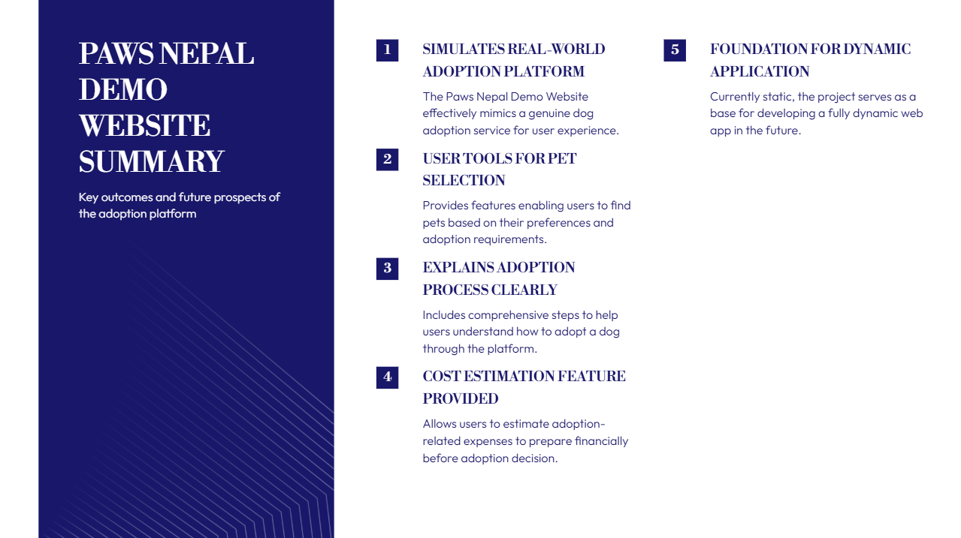

Slide 8
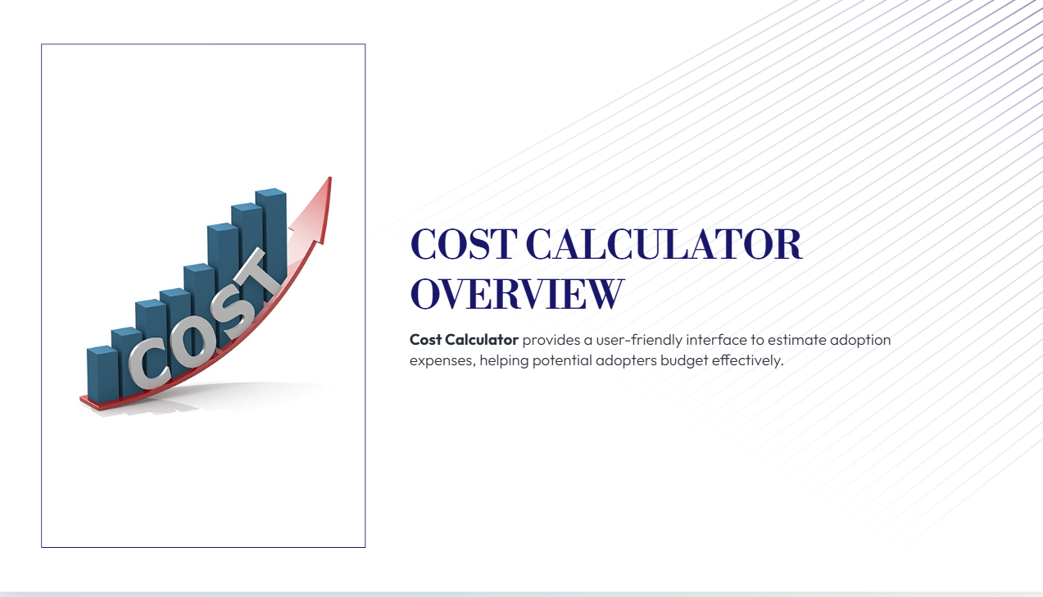

Slide 9
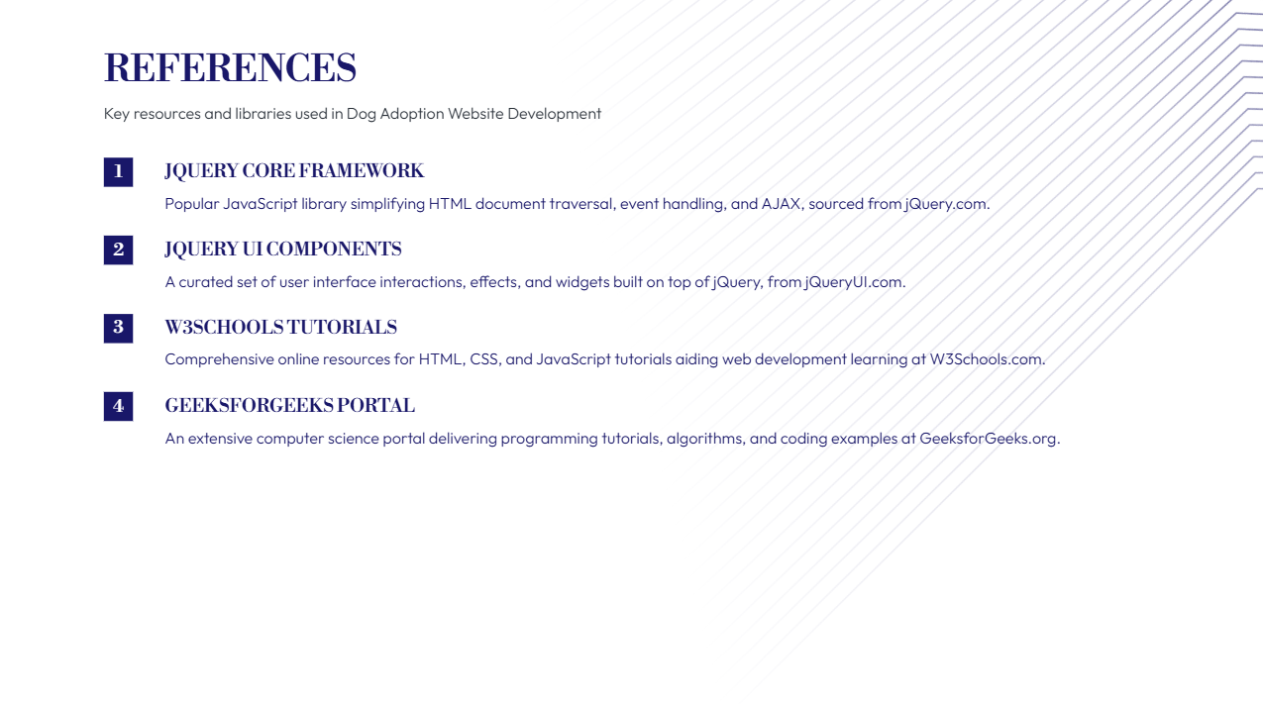

Slide 10
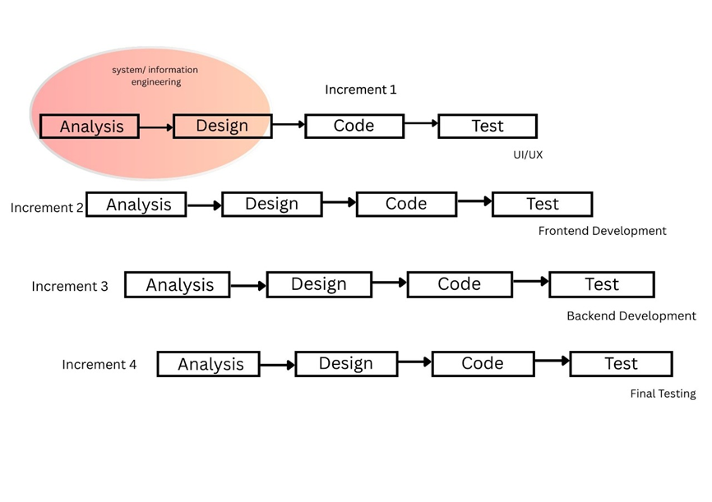

Slide 11
Increments:
Increment1:UI/UX
Increment2: Frontend Development
Increment3: Backend Development
Increment 4: Final Testing

Slide 12

Home Page:

Slide 13
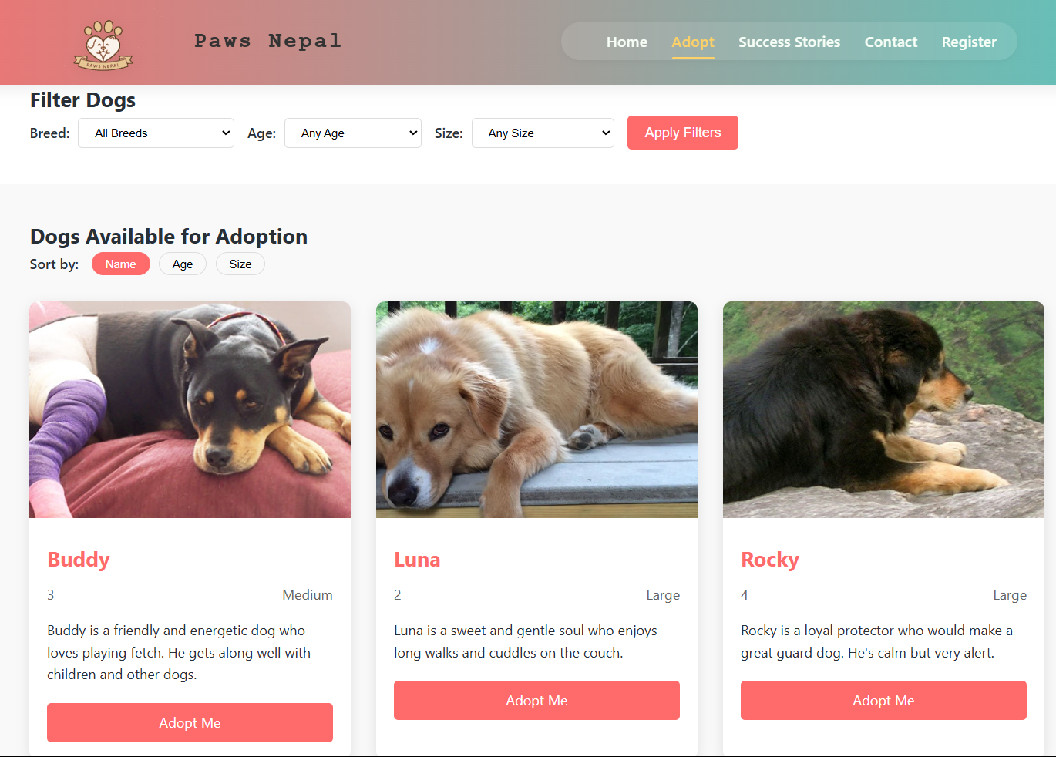
Adaption Page:

Slide 14
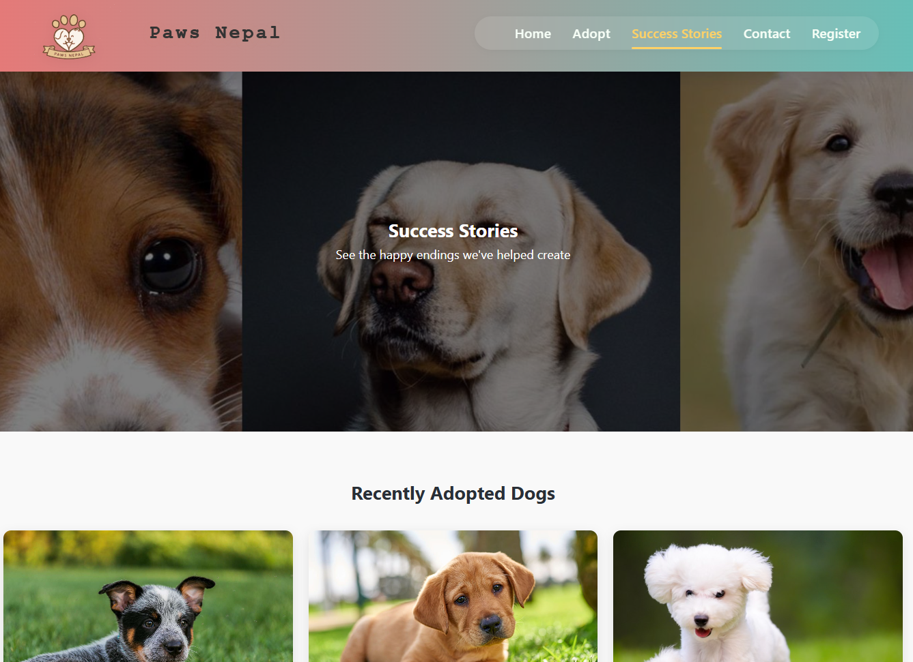
Success Story Page:

Slide 15
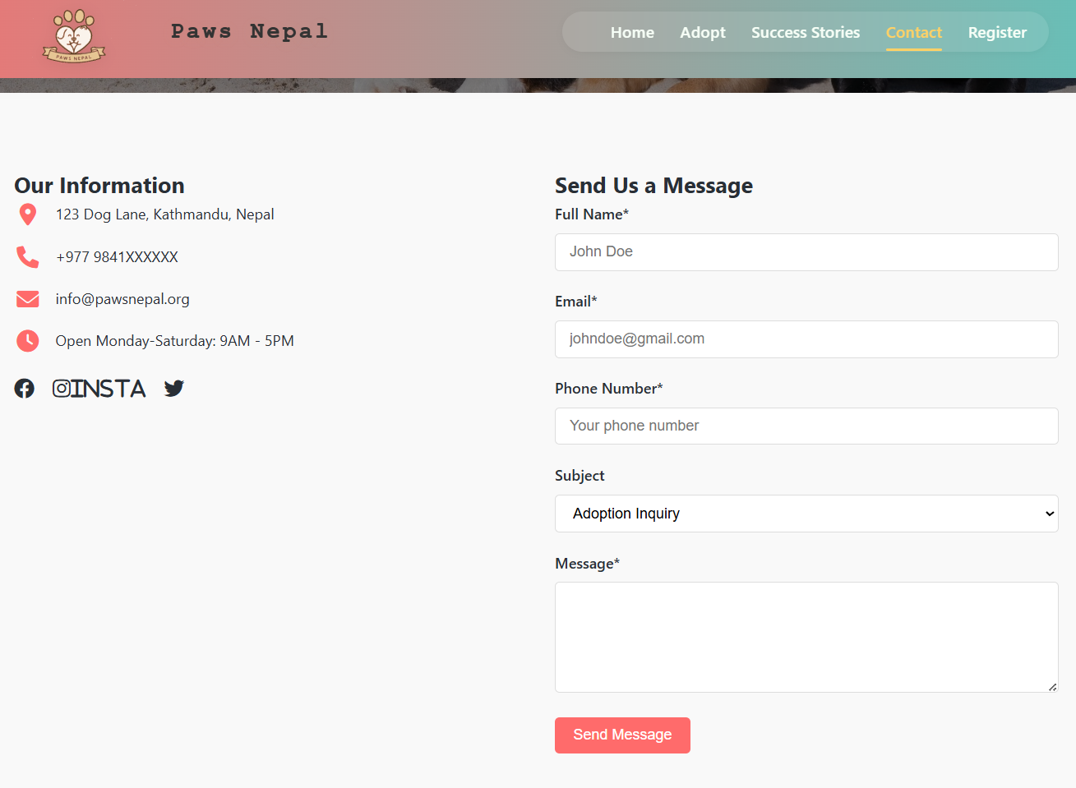
Contact Page:

Slide 16
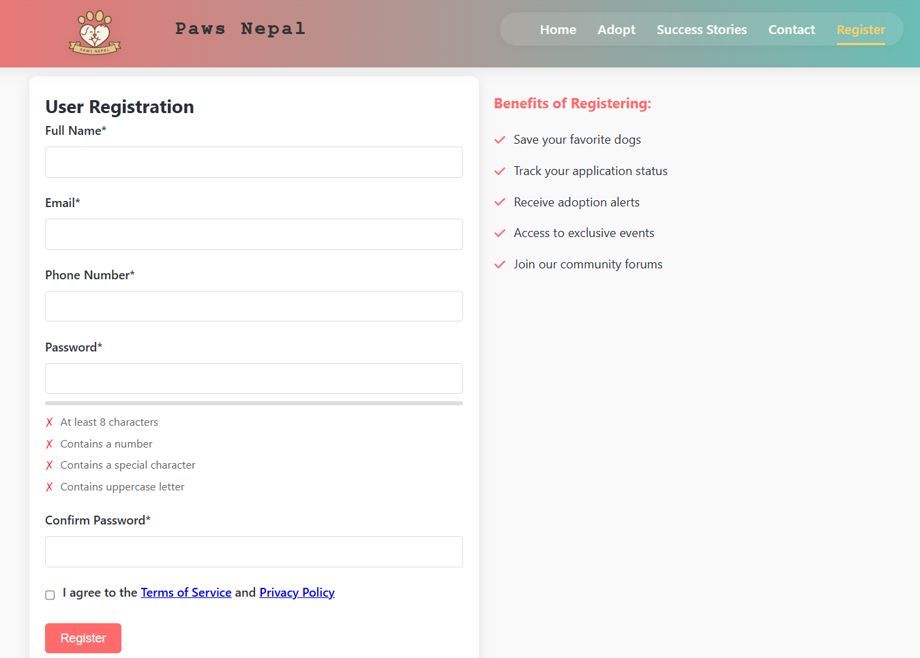
Register Page:

Slide 17


Slide 18


